Slide 1



Bank Loan
Analysis
Group 1

Slide 2
Agenda
Introduction
All KPI’s Analysis & Recommendation
What We Learn
Challenges
Dashboard Screenshots

Slide 3
Introduction
To make create clear charts and graphs that not only tackled the specific KPIs given but also made it simple for everyone to grasp how the company was doing.
This objective pushed me to enhance my data analysis skills and communicate insights visually, helping to make better-informed decisions based on the data.
3

Slide 4
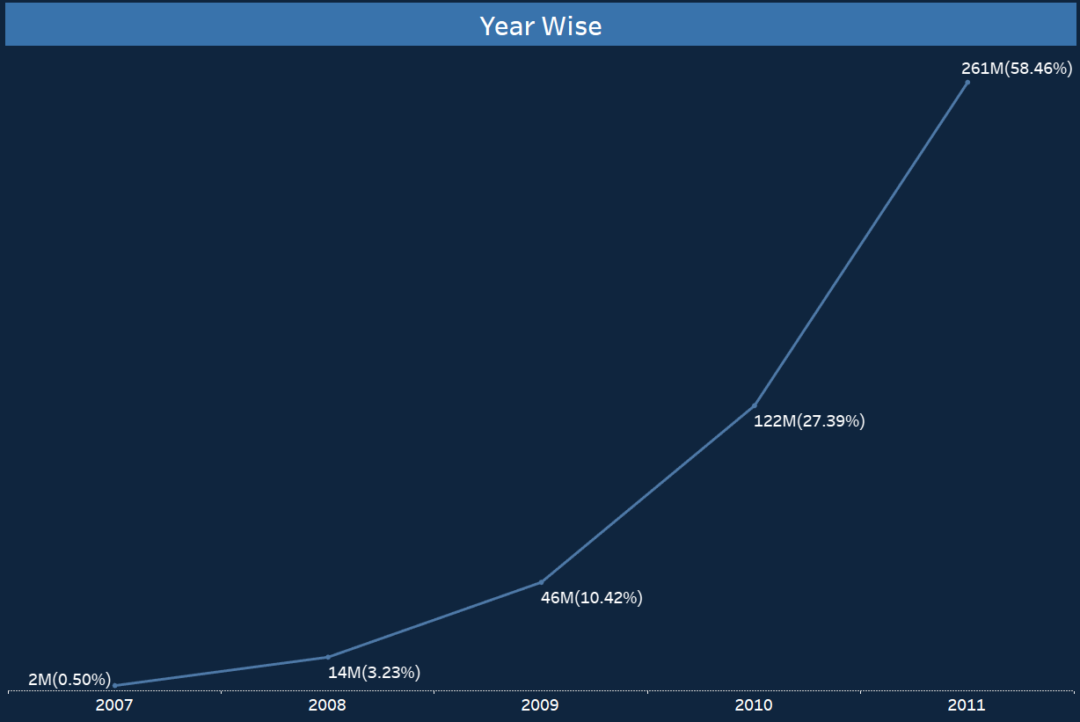
KPI -1 Year wise loan amount stat-
The data reveals a significant upward trend in loan amounts. Starting at $2 million in 2007, the figures steadily climbed to $261 million, suggesting a year-over-year increase in customer borrowing.
Banks can employ several strategies to increase loan volume.
Attract More Deposits:
Competitive Rates: Offer attractive interest rates on savings accounts to incentivize customers to park their money with the bank, creating more funds for lending.
Targeted Products: Develop new deposit accounts tailored to specific demographics or needs, attracting a wider customer base.
4

Slide 5
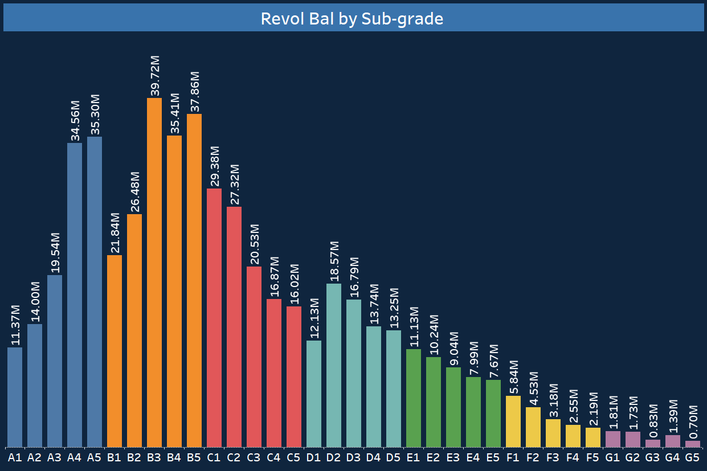
KPI-2 grade & sub-grade wise revol_bal-
Our data reveals a trend where Grade B customers hold the highest revolving balances on their credit cards compared to other grades. Conversely, Grade G customers have the lowest balances.
This pattern seems to correlate with annual income. We see that Grade B customers typically have higher annual incomes, especially for those with over ten years of employment. As income rises, the debt-to-income ratio tends to decrease. This likely explains why more Grade B customers have taken out revolving credit compared to other grades.
In simpler terms, customers with higher incomes (like Grade B) tend to have more credit available to them (higher revolving balances) due to a lower debt burden. This trend seems to continue for other grades, with a descending order of revolving balances from B to G, mirroring the income levels.
5

Slide 6
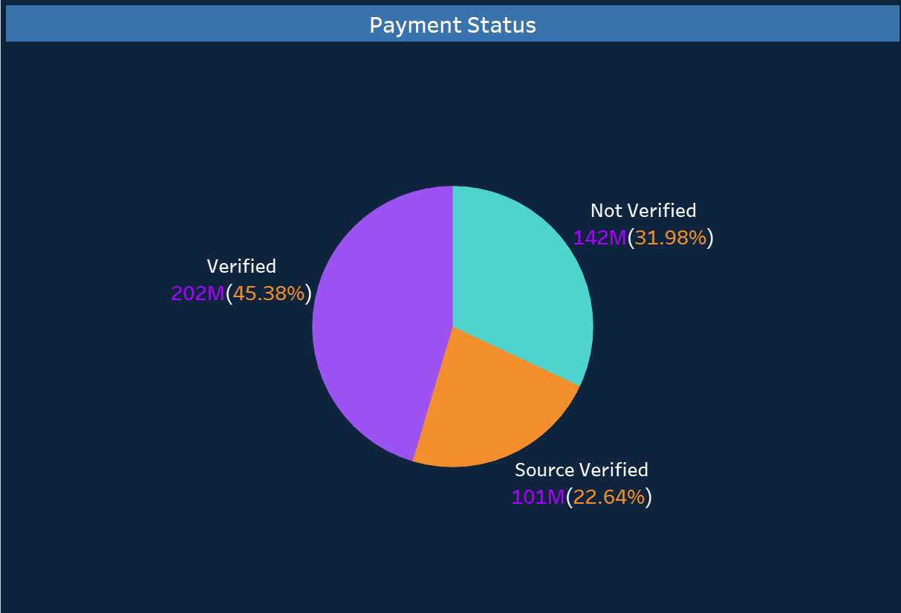
KPI-3 total payment for verified VS non verified status-
Looking at the pie chart, we can see that verified loans contribute the majority (68.02%) of the total payment amount. Unverified loans, on the other hand, represent a smaller portion (31.98%). This highlights the importance of a robust loan verification process to ensure timely and complete payments.
6

Slide 7
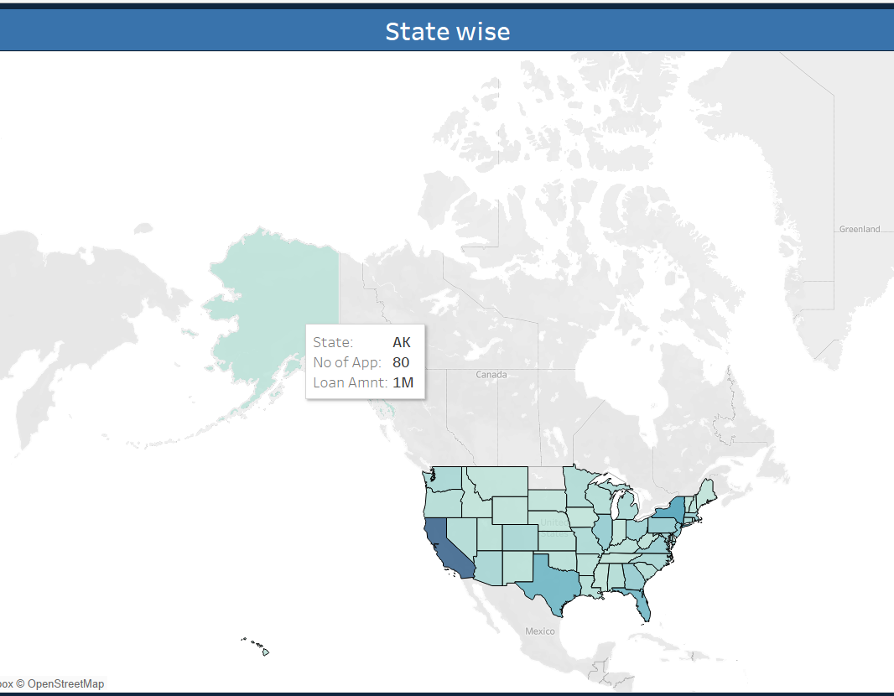
KPI-4 state wise & month wise loan status-
Loan Status Distribution by State
The graph reveals interesting insights into loan activity across different US states. California stands out with the highest number of loans exceeding 5,000 on the specified credit pull date.
Focus on Repayment Rates:
Encouragingly, the data also indicates a high repayment rate across all states. Approximately 97% of bank customers have a "fully paid" status for their loans. This suggests responsible borrowing behavior and potentially strong economic conditions in these areas.
7

Slide 8
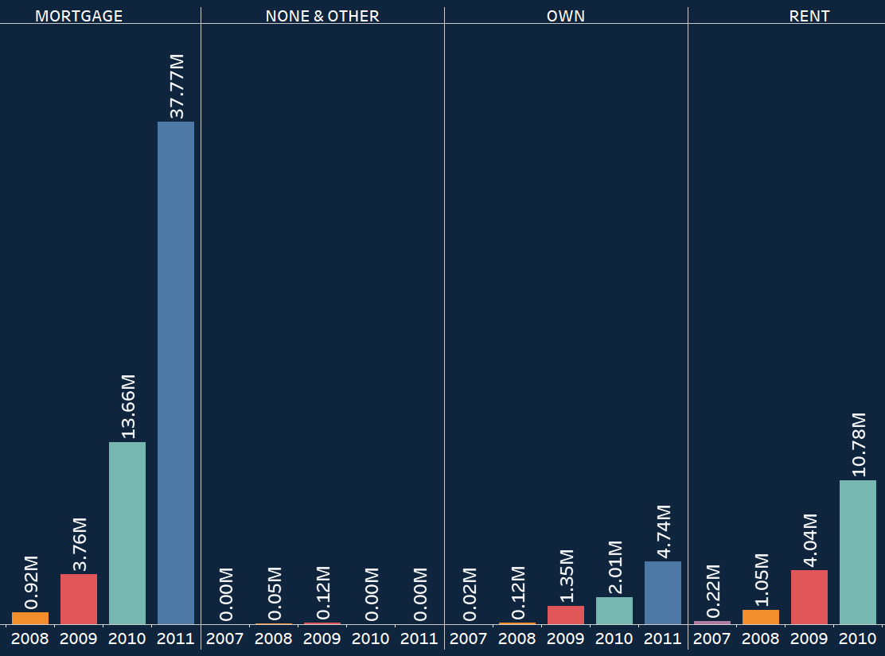
KPI-5 home ownership vs last payment date stats-
The graph highlights that customers with "MORTGAGE" home ownership have made the highest recent payment of $310,798. This significant payment amount suggests that a substantial number of these customers might be nearing the end of their mortgage repayments.
8

Slide 9
Customer Segmentation and Risk Analysis: Based on income and repayment data (verified vs. unverified loans), create customer segments with different risk profiles. Develop targeted loan products and underwriting guidelines for each segment (e.g., stricter requirements for high-risk customers). Loan Performance and Trends: Analyze geographic trends (loan volume and repayment rates). Prescribe strategies to expand loan offerings in high-performing areas while potentially offering loan counseling or alternative loan products in areas with lower repayment rates.
Prescriptive
Analysis
9

Slide 10
Loan Growth and Repayment: Analyze historical trends in loan amounts and repayment rates. Build a model to predict future loan volume and potential default rates. This can help banks adjust lending strategies and risk management practices proactively. Homeownership and Loan Purpose: Develop a model to predict future loan purpose (debt consolidation, mortgage, etc.) based on customer data like homeownership status and income. This can help banks prepare for loan demand and potentially offer targeted loan.
Predictive
Analysis
10

Slide 11
Verification Analysis: Analyze the reasons behind unverified loans (41.12%). Identify bottlenecks in the verification process and prescribe solutions to streamline it.
Diagnostic Analysis
11

Slide 12
Conclusion
By combining these different analyses, banks can gain a comprehensive understanding of their loan portfolio, customer base, and potential risks. This allows for data-driven decision making to improve loan performance, customer satisfaction, and overall business health.
12

Slide 13
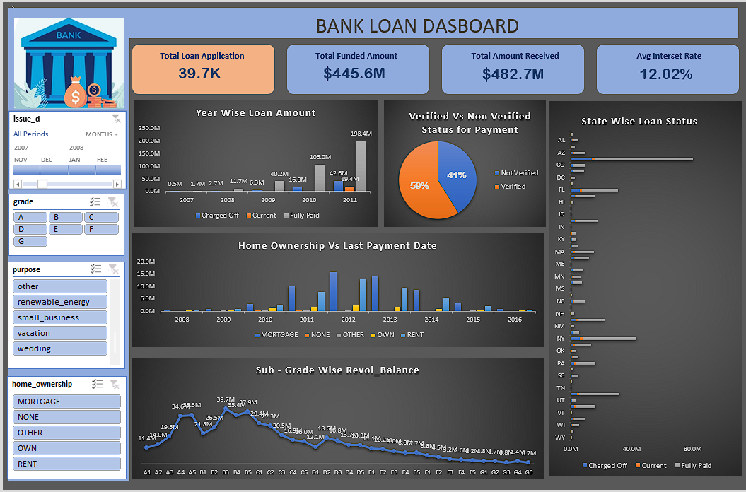
Excel Dashboard – Summary

Slide 14
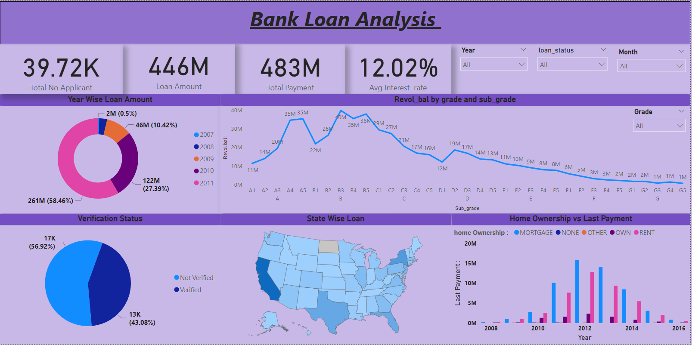
Power BI Dashboard - Summary

Slide 15
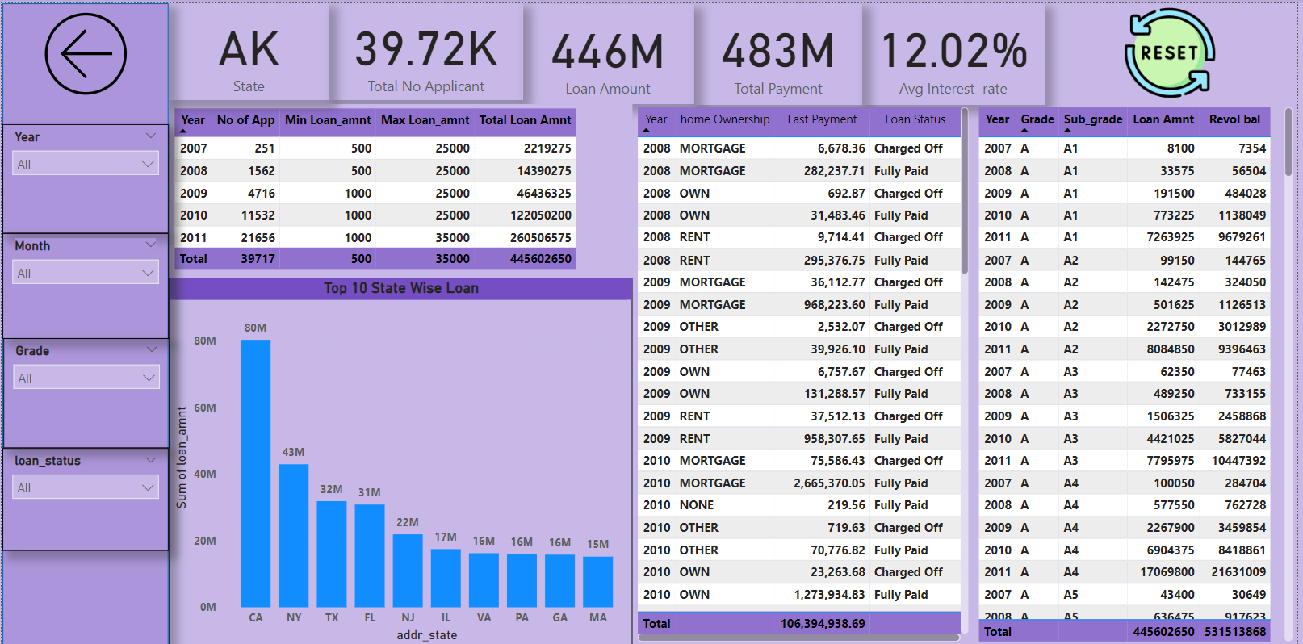
Power BI Dashboard – More Details

Slide 16
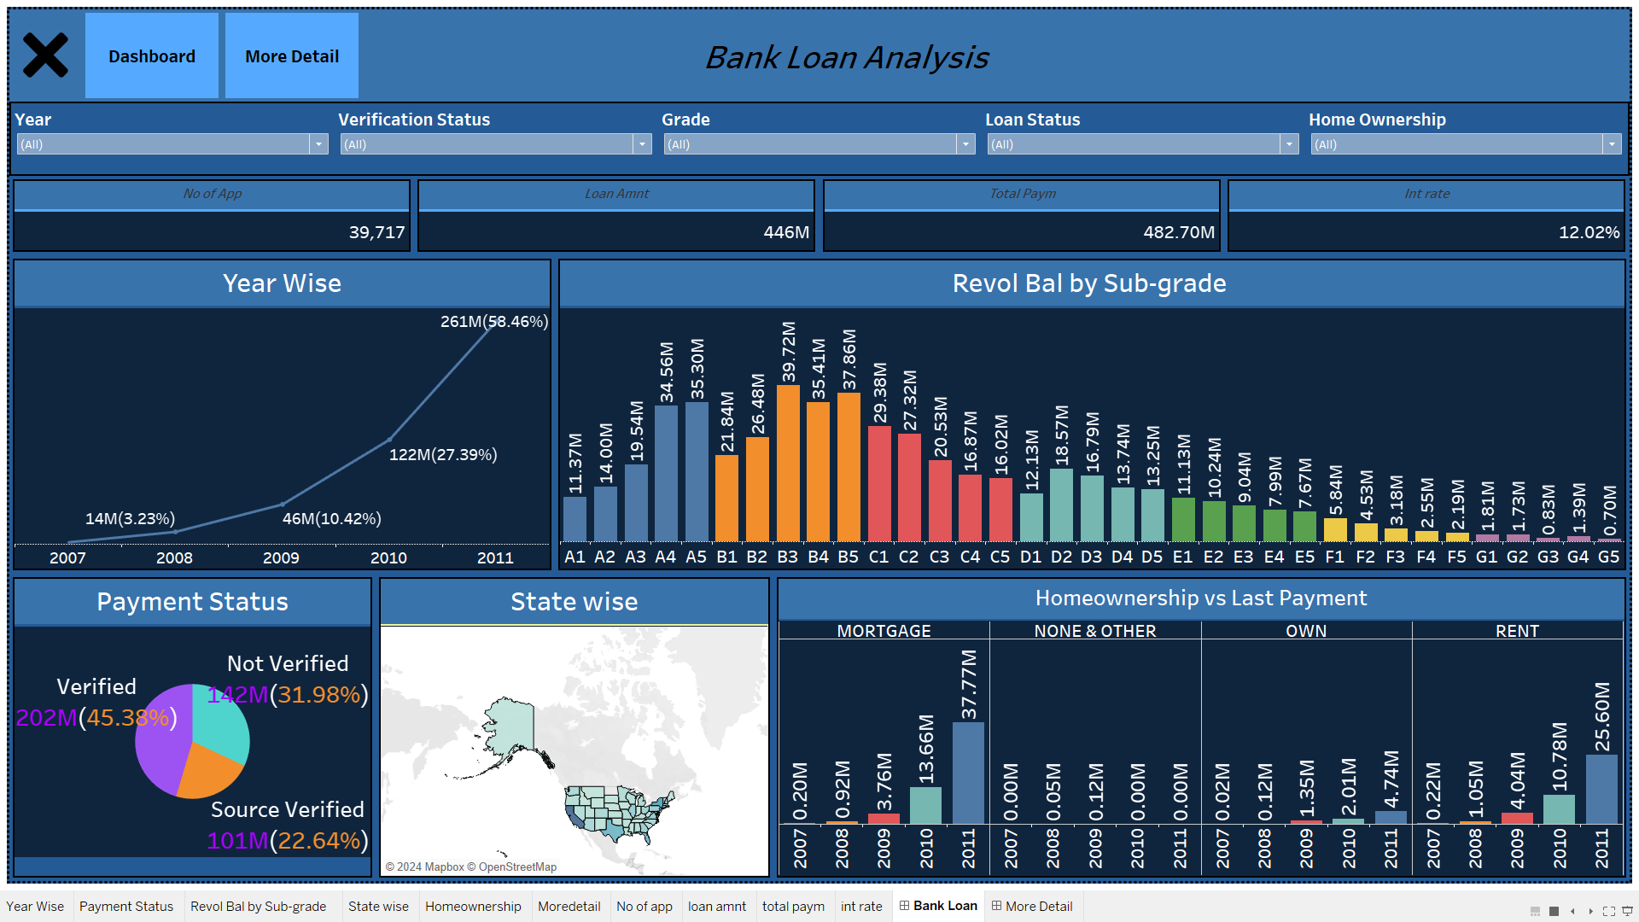
Tableau Dashboard - Summary

Slide 17
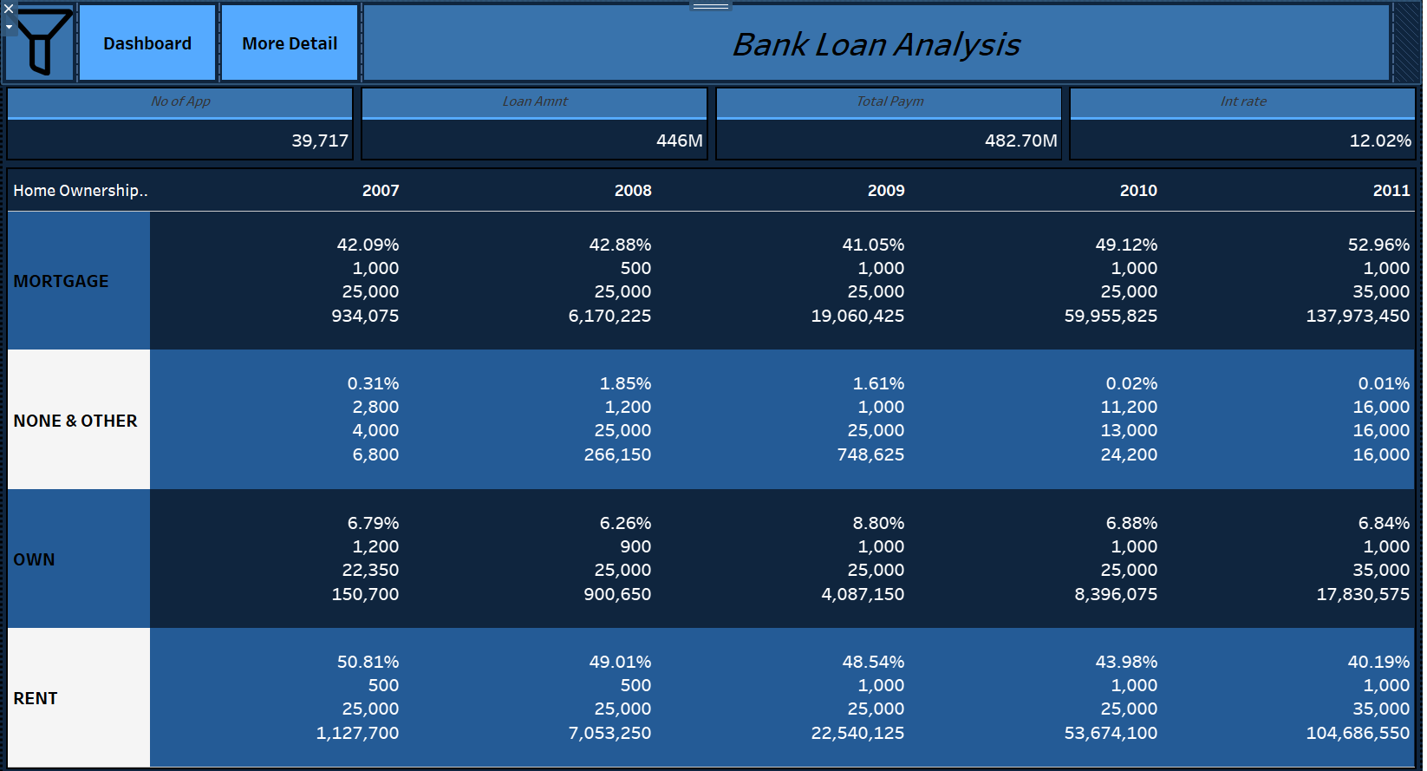
Tableau Dashboard - More Details

Slide 18
Group Members-
Sahil Tiwari
Akshay Renge
Bhavna Kharat
Jishnu Raj P R
Pallavi Waghmare
Nikhil Sai Ronagala
Darsi Venkata Rama Murthy

Slide 19
Thank you

